Slide 1
T5.1 Twinning activities (RCTT) • Review of each twinning (achievements, problems, recommendations) • Final twinning report (status, elements, next steps)
Dr. Alexander A. Uspenskiy
Director
Innovation Association
“Republican Centre for Technology Transfer”
Stuttgart, 06.10.2015

Slide 2
Objective of the twinning program
Objective of the twinning and staff exchange program – exchange of experience of partner organizations from EU countries and organizations from Eastern Partnership countries in the field of technology transfer in the area of energy efficiency and renewable energy.

Slide 3
Participants/Time/Location/Responsibility
T5.1 Twinning and staff exchange (M13-M30, Task leader RCTT) Further partners: SEZ/SIG, IPA, SUA, GTU, NTUU KPI.
Three independent twinning activities between the consortium members (one from EU and one from Eastern Partnership countries) were conducted:
Twinning 1
County/member: Romania - IPA, Ukraine - NTUU KPI
Twinning 2
County/member: Germany - SEZ/SIG, Belarus – RCTT
Twinning 3
County/member: Slovakia - SUA, Georgia - GTU

Slide 4
1. Participants/Time/Location
Twinning 1
County/member: Romania - IPA, Ukraine - NTUU KPI
Step 1: Twinning IPA Craiova – NTUU KPI in Kyiv, Ukraine 3-5 November 2014
Step 2: Twinning IPA Craiova – NTUU KPI in Craiova, Romania 23-25 April 2015

Slide 5
1.1. Twinning 1/Step 1/Objectives
Twinning 1
Step 1: Twinning IPA Craiova – NTUU KPI in Kyiv, Ukraine 3-5 November 2014
1. Objectives of twinning
1.1. Exchange of experience between partner organizations from Romania and organizations from Ukraine in the field of innovation, technology transfer in the area of energy efficiency and renewable energy.
1.2. Collaboration of IPA Craiova and NTUU KPI in order to prepare Ukrainian stakeholders for generating profiles of companies, technology offers, technology requests and express of interest.
1.3. Discussion of possibilities of working together within European projects
1.4. Analysis of the innovative ecosystems and necessary services to support the knowledge transfer
1.5. Discussion of creation of the Regional Technology Transfer Center at NTUU “KPI”

Slide 6
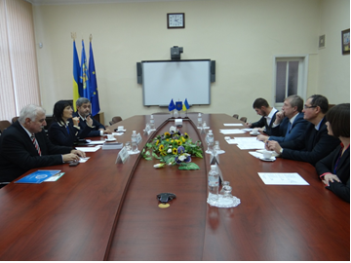
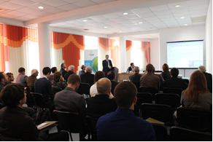
1.1. Twinning 1/Step 1
Step 1: Twinning IPA Craiova – NTUU KPI in Kyiv, Ukraine 3-5 November 2014

Slide 7
1.1. Twinning 1/Step 1/Achievements
Twinning 1
Step 1: Twinning IPA Craiova – NTUU KPI in Kyiv, Ukraine 3-5 November 2014
Results/achievements of twinning
As a result, the sides exchanged views on the above and came to the conclusion about moving of innovative activity of the parties to a higher - interstate level. It was mentioned that the main tool that can serve as entry to European countries innovative market for the Science Park and NTUU ‘KPI’ is Danube network of technology transfer and the creation of a national contact point on the base the Science Park. The sides have agreed to make first steps for expanding the DTC network by the inclusion Ukraine in it.
Dr. Gabriel Vladut suggested using services for clusters that can be developed basing on the tri-ple helix model or clover model by adding the facilitators with the aim to improve the innovative eco-system of NTUU ‘KPI’.
Partners have discussed task 4.3 of the NoGAP project very detailed and adopted a number of important decisions on how to work with researchers and SMEs in order to develop technology offers and technology requests.

Slide 8
1.2. Twinning 1/Step 2/Objectives
Twinning 1
Step 2: Twinning IPA Craiova – NTUU KPI in Craiova, Romania 23-25 April 2015
1. Objectives of twinning
1.1. Exchange of experience between partner organizations from Romania and organizations from Ukraine in the field of innovation, technology transfer in the area of energy efficiency and renewable energy.
1.2. Collaboration of IPA Craiova and NTUU KPI in order to prepare Ukrainian stakeholders for generating profiles of companies, technology offers, technology requests and express of interest, as well as for participation in the 2nd NoGAP Brokerage Event.
1.3. Discussion of possibilities of working together within European projects.
1.4. Analysis of the innovative ecosystems and necessary services to support the knowledge transfer.

Slide 9
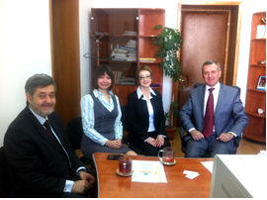
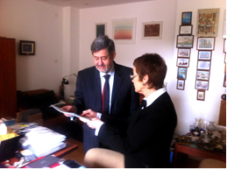
1.2. Twinning 1/Step 2
Step 2: Twinning IPA Craiova – NTUU KPI in Craiova, Romania 23-25 April 2015

Slide 10
1.2. Twinning 1/Step 2/Achievements
Twinning 1
Step 2: Twinning IPA Craiova – NTUU KPI in Craiova, Romania 23-25 April 2015
The following results have been achieved during the twinning:
1. The 3 Agreements on partnership and cooperation were signed between the Science Park “Kyivska Polytechnica” and the following parties: SC IPA SA Craiova, University of Craiova, SC Cardimed SRL. These Agreements are aimed at promoting joint effort and teaming the Parties' expertise with the view to development of the innovation implementation practices, help develop and implement innovation projects. Furthermore, according to these agreements the above mentioned Romanian organizations received rights to operate in the ecosystem of the Science Park “Kyivska Polytechnica” namely work with its scientists using its facilities and other equipment.
2. SC IPA SA Craiova and The Science Park “Kyivska Polytechnica” took part in the preparation of the OPTIMUS project for HORIZON 2020 Call: H2020-INSO-2015-CNECT.
3. Participants agreed that SP “KP” will invite representatives of the University of Craiova and S.C. IPA S.A. CIFATT Craiova to the All-Ukrainian Festival of Innovation Projects “Sikorsky Challenge”, which is held annually at the NTUU “KPI”. This will lead to the strengthening of partnerships and a better exchange of experience in the field of innovation development.
4. The strategy of implementation TO/TR prepared within the NoGAP project was discussed and adopted, which will allow to boost the achievement of project targets in terms of timing and quality.
5. Areas of partners’ competence, which are the most developed among the participants and can be a competitive advantage in the markets for technology transfer, were identified. It is expected that in the future this will lead to successful collaborative projects.
6. Potential participants to participate in consortia of European innovation programs (Horizon 2020 et al.) were identified, which will allow strengthening Ukrainian-Romanian R&D collaboration.

Slide 11
1.2. Twinning 1/Conclusion
Twinning 1
Conclusion
Networking could be seeing as one of the major tools for bridging the gap between research, innovation and business creation as well as between organizations, countries and cultures. When thinking about this purpose, a significance of personal meetings with possible partners, exchange of ideas and solutions for mutual issues and discussion of possible ways of future cooperation cannot be overestimated.
Both twinning events organized within the NoGAP project lead to achievement of its objectives namely: promoting networking in the field of energy efficiency and renewable energy between people and organizations from different areas and different countries. The new opportunities of implementing on practice the expertise acquired within the project seem to be a good foundation for future collabo-ration and for multiplication of project achievements.

Slide 12
2.1. Twinning 2/Step 1/Objectives
Twinning 2
Step 1: SEZ/SIG (in Belarus, Minsk - RCTT) – May 2015
1. Objectives of twinning
1.1. Exchange of experience between partner organizations from Belarus and organizations from Germany in the field of innovation, technology transfer in the area of energy efficiency and renewable energy.
1.2. Collaboration of SEZ Germany and RCTT in order to train Belarusian stakeholders for preparing business plans, generating profiles of companies, technology offers, technology requests and express of interest, innovation training for multiplicators.
1.3. Discussion of possibilities of working together within European projects.

Slide 13
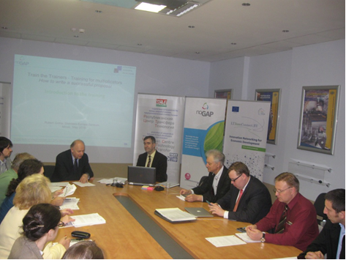
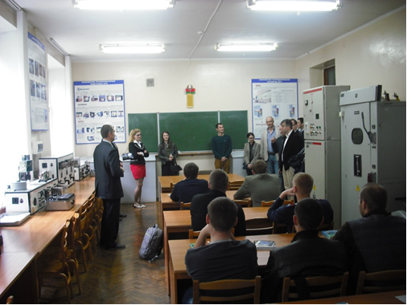
2.1. Twinning 2/Step 1
Twinning 2
Step 1: SEZ/SIG (in Belarus, Minsk - RCTT) – May 2015

Slide 14
2.1. Twinning 2/Step 1/Achievements
Twinning 2
Step 1: SEZ/SIG (in Belarus, Minsk - RCTT) – May 2015
Results/achievements of twinning:
1. The NoGAP Transfer Week I (Belarus-Germany) gathered about 50 participants from 3 countries (Belarus, Germany and Moldova). Among the participants - representatives of SEZ, RCTT and its branch offices, BSATU, NCPs, technoparks, SMEs, the NAS of Belarus and representatives of the Moldovan innovation enterprises and organizations. Deputy Chairman of the NAS of Belarus Academician Sergei Kilin took part in the opening the Innovation Training for multiplicators: Innovation Strategies, Technology Transfer and Funding Opportunities. In the framework of the Week, guests from Germany and Moldova, in particular, were informed about RCTT, the NAS of Belarus and BSATU activities and also visited the exhibition of the NAS of Belarus "Achievements of the National Science for the Industrial Sector", museums of the NAS of Belarus and BSATU.
2. Participants from Belarus and Moldova had trainings in business plan writing, innovation strategies, technology transfer and funding opportunities from EU funds, were trained in the preparation of TO, TR and EoI according the Enterprise Europe Network (EEN) requirements.

Slide 15
2.2. Twinning 2/Step 2/Objectives
Twinning 2
Step 2: RCTT (in Germany, Karlsruhe - SEZ/SIG) – June 2015
1. Objectives of twinning
1.1. Participation in the 2nd NoGAP Brokerage Event in Frankfurt am Main on 16 June
1.2. Exchange of experience between partner organizations from Belarus and organizations from Germany in the field of innovation, technology transfer in the area of energy efficiency and renewable energy.
1.2. Discussed instruments of financing RCTT’s projects from EU funds and prospects for collaboration between RCTT and German firms in the field of technology transfer.
1.3. Discussion of possibilities of working together within European projects.

Slide 16
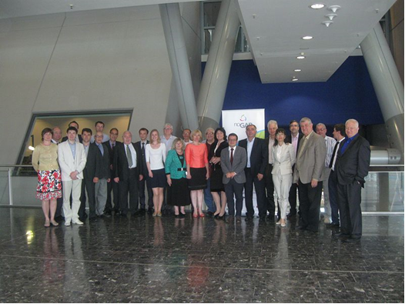
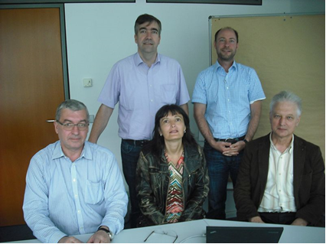
2.2. Twinning 2/Step 2
Twinning 2
Step 2: RCTT (in Germany, Karlsruhe - SEZ/SIG) – June 2015

Slide 17
2.2. Twinning 2/Step 2/Achievements
Twinning 2
Step 2: RCTT (in Germany, Karlsruhe - SEZ/SIG) – June 2015
The following results have been achieved during the twinning:
1. The Participants of the twinning acquired experience of participation in brokerage events discussed prospects for collaboration in the EU programs.
2. RCTT and SEZ exchanged of experience in the field of innovation, technology transfer in the area of energy efficiency and renewable energy.
3. Representatives of RCTT acquainted with the possibilities and instruments of financing of innovative projects from EU funds.

Slide 18
3. Twinning 2/Step 1/Objectives
Twinning 3
Step 1: GTU (in Slovakia, Nitra - SUA) – 25-26 September 2014
Objectives:
1. To exchange experience between partner organizations from Slovakia and organizations from Georgia in the field of innovation and technology transfer in the area of energy efficiency and renewable energy;
2. To assist Georgian companies to generate profiles, technology offers, technology requests and expression of interest;
3. To discuss possibilities for further collaboration in H2020 forthcoming Calls, in Cross border, Erasmus + and other programs;
4. To discuss the possibility of establishment of the Regional Technology Transfer Center in Georgia, with participation of appropriate organizations from Armenia and Azerbaijan.

Slide 19
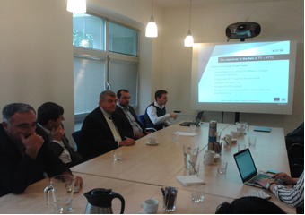
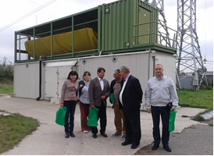
3. Twinning 2/Step 1
Twinning 3
Step 1: GTU (in Slovakia, Nitra - SUA) – 25-26 September 2014

Slide 20
3. Twinning 3/Step 1/Achievements
Twinning 3
Step 1: GTU (in Slovakia, Nitra - SUA) – 23-26.9.2014
Results/achievements of twinning
1. Agriculture has always been the traditional priority of Georgia. Due to political changes in the beginning of 90-ies, followed by the failure of economic, scientific and education systems, agricultural sciences (like most of the fields of sciences) faced stagnation. Consequently, in particular it became fragmentized. On the one hand, there are research teams and labs, which have survived and conduct their research, on the other hand they suffer from the lack of links to practice and relevant business, innovation and technology transfer process. AgroBioTech with its scope of activities is a relevant paradigm for Georgian researchers. The members of the Georgian team in cooperation with Slovak partners will support the cultivation of the best practice and experience of AgroBioTech in Georgia.
2. Though the Technology Transfer Centers of various profiles exist in Georgia, their activities are still limited. The reason is the lack of experience, gap between the research and enterprise, legislation obstacles (the latter is in the process of improvement) etc. In this respect the visit to the Technology Transfer Centre at SCSTI in Bratislava was very important. Georgian participants had intensive discussion and exchange of opinions with their host counterparts. As one of the main goals of the NoGAP project is to establish the TTC in Georgia, experience of TTC at SCSTI will be taken into account by the Georgian partners.
3. The visit to Bratislava National Centre for research and application of renewable energy sources at the Slovak University of Technology was very interesting for the Georgian participants as with regard to the new technologies, also the management of the science. It should be noted the booklets and the books about the renewable energy presented to the guests. Experience of NC is very important for the faculty of energy of GTU.

Slide 21
3. Twinning 3/Step 2/Objectives
Twinning 3
Step 2: Twinning SUA Slovakia – GTU Georgia in Tbilisi, Georgia 17-18 May, 2015
Objectives:
Discussion and brokerage of mutual opportunities;
Exchange of experience concerning the creation of Danube Center;
Profiles, technology offers, technology requests and expressions of interest generated by Georgian companies;
Identification of potential counterparts for further collaboration in European projects (Horizon 2020, Erasmus+, etc.);
Future perspectives of cooperation between SUA and GTU.

Slide 22
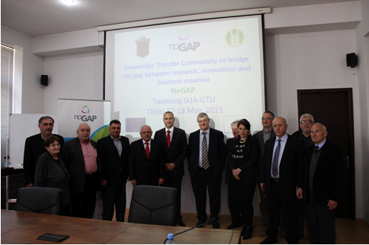
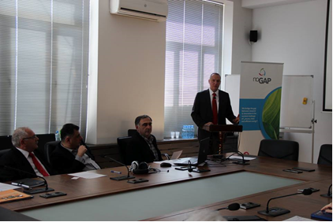
3. Twinning 3/Step 2
Twinning 3
Step 2: Twinning SUA Slovakia – GTU Georgia in Tbilisi, Georgia 17-18 May, 2015

Slide 23
3. Twinning 3/Step 2/Achievements
Twinning 3
Step 2: Twinning SUA Slovakia – GTU Georgia in Tbilisi, Georgia 17-18 May, 2015
To resume it should be mentioned that the twinning activity in the frame of NoGAP project as in Slovakia so in Georgia was very important for the cooperation of universities, their authorities, representatives, scientific staff, technologists, etc. There were established two MoUs between Slovak Agriculture University and two Georgian universities, Georgian Technical University and Georgian Agriculture University. We hope that Slovakian and Georgian organizations, involved in the twinning process will continue the cooperation after the completion of the NoGAP project. It means that due to the mutual meetings the process acquired enough background of sustainability.

Slide 24
Recommendations
To resume it should be mentioned that the twinning activity in the frame of NoGAP project Romania - IPA, Ukraine - NTUU KPI; Germany - SEZ/SIG, Belarus – RCTT; Slovakia - SUA, Georgia – GTU) was very important for the cooperation of universities, centres for technology transfer, R & D institutions and SMEs. The 3 Agreements on partnership and cooperation were signed between the Science Park “Kyivska Polytechnica” and the following parties: SC IPA SA Craiova, University of Craiova, SC Cardimed SRL. These Agreements are aimed at promoting joint effort and teaming the Parties' expertise with the view to development of the innovation implementation practices, help develop and implement innovation projects. Furthermore, according to these agreements the above mentioned Romanian organizations received rights to operate in the ecosystem of the Science Park “Kyivska Polytechnica” namely work with its scientists using its facilities and other equipment. There were established two MoUs between Slovak Agriculture University and two Georgian universities, Georgian Technical University and Georgian Agriculture University. Romania – IPA and Ukraine - NTUU KPI; Germany - SEZ/SIG and Belarus – RCTT; Slovakia – SUA and Georgia - GTU and other organizations, involved in the twinning process can and must continue the cooperation after the completion of the NoGAP project. In the framework of the Horizon 2020 and other EU Programs.

Slide 25
Final Report
Final Report (all Twinings) will be prepared by RCTT till 30.11.2015

Slide 26
Thank you for your attention…
Dr. Alexander A. Uspenskiy Director
Republican Centre for Technology Transfer
66 - 100, Nezavisimosti Ave.,
Minsk 220072, Belarus
Tel.: +375 17 2841499
Fax: +375 17 2840749
E-mail: uspenskiy@mail.ru

